Slide 1
Theory of Automata and Formal languages
Lecture no 2
(Basic Concepts to Drive the Course)

Slide 2
Languages

Slide 3
Language
In English, there are at least three different types of entities: letters, words, sentences.
Letters are from a finite alphabet { a, b, c, . . . , z }
Words are made up of certain combinations of letters from the alphabet.
Not all combinations of letters lead to a valid English word.

Slide 4
Sentences are made up of certain combinations of words.
Not all combinations of words lead to a valid English sentence.
So we see that some basic units are combined to make bigger units.

Slide 5
Languages
How can you tell whether a given sentence belongs to a particular languages
  Black is cat the
  The tea is hot
  I like chocolates two much
Rules give a clue to forming as well as validating sentences.

Slide 6
Formal vs. Informal Rules
Informal language
Incoherent strings are also understandable
    Like idiom
Raise ambiguity
  Interpretation varies with region
  Same words have multiple meanings.
    Like, light, base, etc.

Slide 7
Informal languages
Natural languages are generally defined informally
Human brain
  Capable to understand incoherent even invalid sentences.
    You mangoes like
  Rectify grammatical errors etc.
  Resolve ambiguity
    Interpret according to context
    Supporting aids such as Facial expressions and body language etc.

Slide 8
How to Communicate with machines ?
Need a language: what sort
Machines don’t have human mind though may have its partial imitation
Would fail on incorrect or ambiguous input
  Some recovery or input corrections may be proposed but again very limited.
Thus need a precise, explicit and universal definition of communication language

Slide 9
Summary of Languages
Three aspects/specifications
  Lexical
    Defines valid words/units of a language
  Syntactic
    Defines rules for combining the units to form valid sentences (computer programs in context of machines)
  Semantic
    Concerned with the interpretation or meaning of a sentence (what output to produce in context of machines)
    Affected by ambiguity the most.

Slide 10
Formal languages
Rules defined explicitly and clearly
No ambiguities
Universally uniform understanding
Lets the machine
  Interpret an input uniformly every time. i.e. always produces same output for a particular input
  Explicitly reject invalid input

Slide 11
Formal Languages
Need uniformly understandable notation
Representations
  Alphabet
    Represents a finite set of fundamental units of lanauges, e.g. for English ∑ = {a,b,…,z, A,…Z,}
    ∑ = {0,1}
  ∑ = {0,1,2,3,4,5,6,7,8,9}

Slide 12
Formal Languages
  List of words
    Set of all valid words of a given language, e.g., a language English_Words that contains all valid words of English would have a:
     = {all entries of the dictionary + punctuation marks and blank space….}
    Denoted by 
Strings: A string is a finite sequence of symbols chosen from alphabet.
For example
  0111100 , 123045, abbbcdeg etc.

Slide 13
String Variable: A letter used for denoting a string. The author uses w, x, y and z as string variable. For example
  w = 0111100 , x = 123045, z = abbbcdeg
Length of String: The number of positions for symbols in the string. For simplicity we can say that it is the number of symbols in the string. For example
  |w| = 7 , |x| = ? , |z| = ?

Slide 14
Finite vs. Infinite Languages
Finite Languages
  Countable set of words
  Can be defined by rigorously listing the words in 
  E.g. English_Words

Slide 15
A finite language is a set of strings, where each string in the set has a finite length. In other words, a finite language is a language that contains a finite number of strings, and each string in the language is made up of a finite number of symbols.
Formally, a finite language L can be defined as
L = {s1, s2, ..., sn}, where each si is a string consisting of a finite number of symbols from some alphabet Σ. The number of strings in L is denoted by |L|, and is finite by definition. The length of a string s is denoted by |s|, and is also finite for every string s in L.
Courtesy Costas Busch - RPI

Slide 16
Finite languages are an important concept in computer science and mathematics, and they are used to represent many different types of structures, including regular languages, context-free languages, and more.
Set of all words of length two over the alphabet {a, b}, which is {aa, ab, ba, bb}.
Courtesy Costas Busch - RPI

Slide 17
Infinite Languages
  Infinite set of valid words
  Can’t be listed completely
  E.g. English_Sentences
In contrast to finite languages, infinite languages are sets of strings that contain an infinite number of elements. There are two main types of infinite languages: countably infinite and uncountably infinite languages.
Courtesy Costas Busch - RPI

Slide 18
Infinite Languages
Most of the languages are infinite
How can u check whether a word belongs to a language if it is
  Finite
    Checking its entry in 
  Infinite
    Validating against rules

Slide 19
Defining Languages
Define alphabet set
Define rules for forming valid words and sequences of words from ∑
  Called grammar
  Can be descriptive
  Can be mathematical
    Can also define supporting functions e.g., length(X), reverse(x)

Slide 20
Defining languages
Example ∑={a,b,…z}
  L = {all words formed only of odd number of x’s}
  Or, L = {x^{n} | n is odd}
  We interpret the set L as "the set of all strings of the form x^n, where/such that n is an odd positive integer."
  L = {all words of length less than or equal to 4}
  PALINDROME ={Λ, all strings x such that reverse (x) = x}

Slide 21
Kleene Closure
Set closure
Kleene Closure (applied to ∑)
  A set of all the strings (finite) that can be formed by the elements of ∑ where the elements may be repeated any number of times.
  Denoted by ∑*
  Also called Kleene star.

Slide 22
∑* : The set of all strings over an alphabet ∑ and called Kleene Star Closure of alphabet. So we have
  ∑* = ∑⁰ U ∑¹ U ∑² U ∑³ U……………
∑⁺ : The set of all strings over an alphabet ∑ excluding empty string, ε, and called plus operation. So we have
  ∑⁺ = ∑¹ U ∑² U ∑³ U……………

Slide 23



The * Operation
: the set of all possible strings from
alphabet

Slide 24


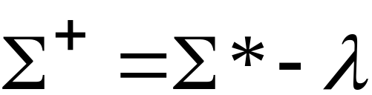
The + Operation
: the set of all possible strings from
alphabet except

Slide 25
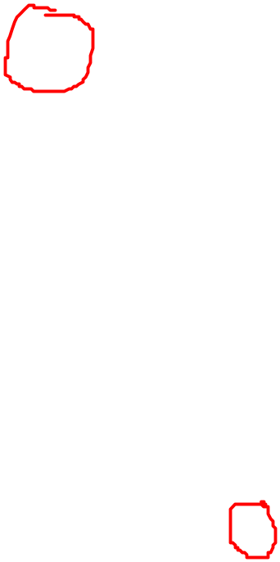
Some observations
Λ represents an empty string (not alphabet thus not a part of ∑)
ε also represents the same
ε is not equivalent to ϕ
If ∑ = ϕ then
  ∑* = {λ}

Slide 26
Σ represents a set of symbols or alphabet, and Σ* represents the set of all possible strings that can be formed using symbols from Σ, including the empty string denoted by λ.
So, if Σ = ϕ (i.e., the set of symbols is empty), then the only string that can be formed from it is the empty string, which is denoted by λ.
Courtesy Costas Busch - RPI

Slide 27
Question:
  Is S* == (S*)* ? → (RHA)
Courtesy Costas Busch - RPI

Slide 28
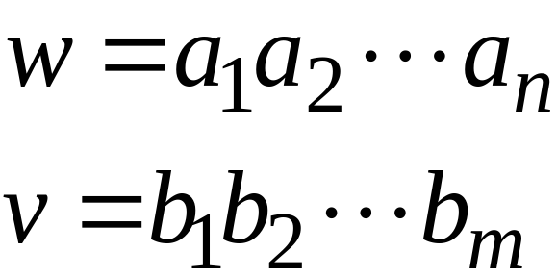
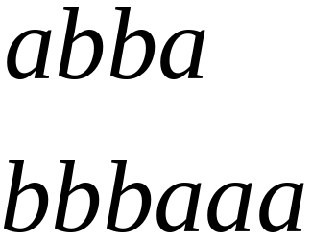
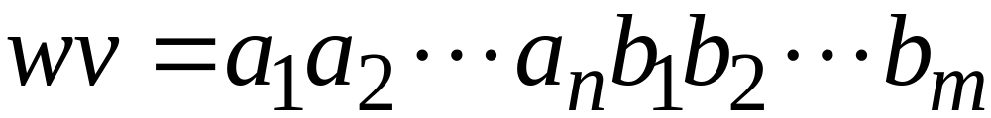

String Operations
Concatenation

Slide 29




Reverse

Slide 30


String Length
Length:
Examples:

Slide 31
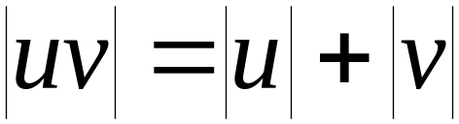

Length of Concatenation
Example:

Slide 32
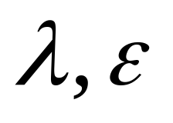
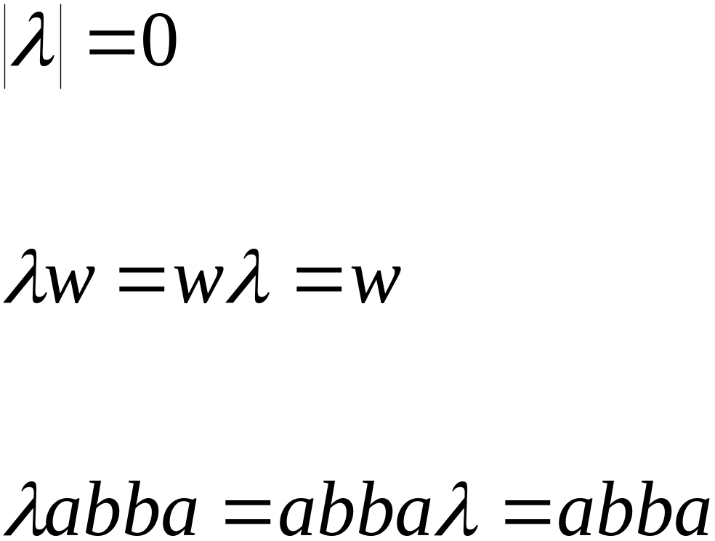
Empty String
A string with no letters:
Observations:

Slide 33


Substring
Substring of string:
  a subsequence of consecutive characters
String Substring

Slide 34




Prefix and Suffix
Prefixes Suffixes
prefix
suffix

Slide 35




Another Operation
Example:
Definition:

Slide 36


Languages
A language is any subset of
Example:
Languages:

Slide 37
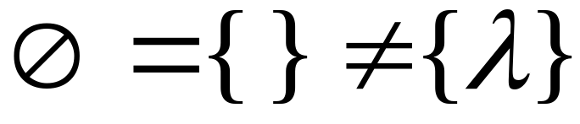




Note that:
Sets
Set size
Set size
String length

Slide 38




Another Example
An infinite language

Slide 39


Operations on Languages
The usual set operations
Complement:

Slide 40



Reverse
Definition:
Examples:

Slide 41


Concatenation
Definition:
Example:

Slide 42



Another Operation
Definition:
Special case:

Slide 43



More Examples

Slide 44
The * Operation
: the set of all possible strings from
alphabet

Slide 45


Star-Closure (Kleene *)
Definition:
Example:

Slide 46
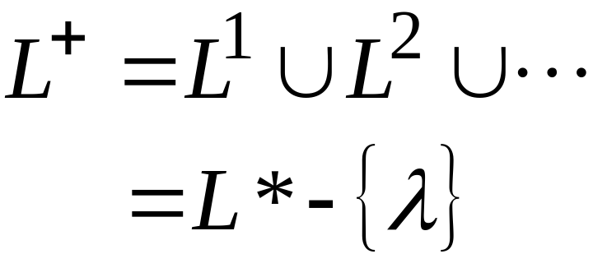

Positive Closure
Definition:

